Slide 1

CS654: Digital Image Analysis
Lecture 17: Image Enhancement

Slide 2
Recap of Lecture 16
Mask processing
Spatial filtering
Averaging
Differentiation
Correlation
Convolution

Slide 3
Outline of Lecture 17
Image enhancement
Dynamic range
Point processing
Contrast stretching
Intensity level slicing

Slide 4
Introduction
Improve the quality of an image as perceived by human being
Can be performed at both spatial and frequency domain
Different types of enhancement
Noise suppression
Increase contrast
Sharpen or smoothen image feature
Emphasise
Display and analysis

Slide 5
Common techniques
Image enhancement
Point processing
Spatial operation
Transform operation
Pseudocoloring
Contrast stretching
Noise clipping
Window slicing
Histogram modeling
Noise smoothing
Median filtering
Unsharp masking
Filtering
Linear filter
Root filter
Homomorphic filter

Slide 6
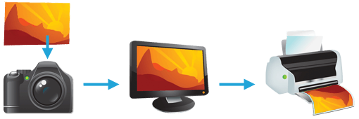
Dynamic Range
The ratio between the maximum and minimum measurable light intensities
In the real world, one never encounters true white or black
Image: cambridgeincolour

Slide 7
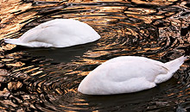
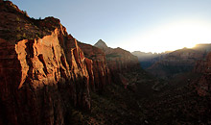
ILLUMINANCE & REFLECTIVITY
Both contribute to the dynamic range of a scene
Illuminance to specify only incident light
Vast variation possible for incident light

Slide 8
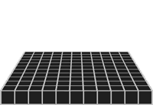
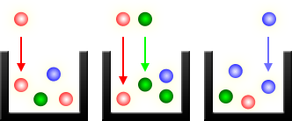
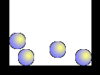
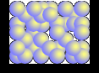

Dynamic Range of Camera
Cavity Array
Light Cavities
Black Level (Limited by Noise)
White Level (Saturated)
Darker White Level (Low Capacity)
Image: cambridgeincolour

Slide 9
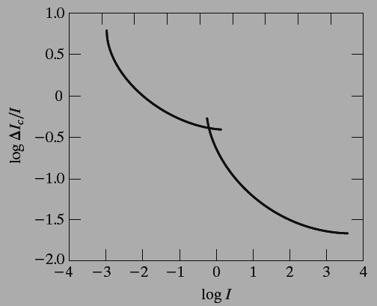
Human eye
Images: Gonzalez & Woods, 3rd edition
Weber ratio as a function of intensity
HDR Images, Posterization

Slide 10
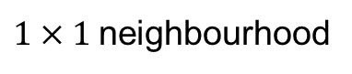
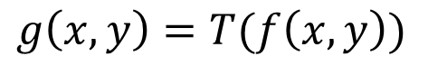
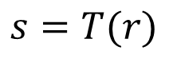

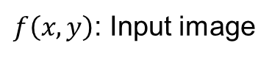
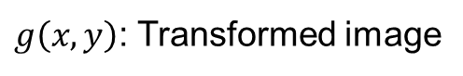
Intensity transformation
Images: Gonzalez & Woods, 3rd edition
$$g\left(x,y\right)=T(f\left(x,y\right))$$
$f\left(x,y\right)$: Input image
$g\left(x,y\right)$: Transformed image
$T$: Transformation function
$1×1$neighbourhood
$$s=T(r)$$
Point processing

Slide 11
Point processing
Images: Gonzalez & Woods, 3rd edition
255
255
0
255
0
255
Contrast stretching function
Thresholding function

Slide 12
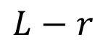
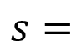
Intensity transformation: Negative
Images: Gonzalez & Woods, 3rd edition
Transformation function
$$s=$$
$$L−r$$

Slide 13
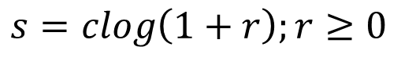
Intensity transformation: Log-transform
Images: Gonzalez & Woods, 3rd edition
Transformation function
$$s=clog\left(1+r\right);r≥0$$
Maps narrow low intensity to wider range of intensity
Compresses the dynamic range of images

Slide 14
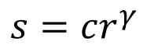
Intensity transformation: Gamma
Images: Gonzalez & Woods, 3rd edition
Transformation function
$$s=cr^{γ}$$
Fractional value maps narrow low intensity to wider range of intensity
Higher value maps narrow low intensity to wider range of intensity

Slide 15
Gamma correction: Display
Images: Gonzalez & Woods, 3rd edition
Gamma correction
Original image
Input image as viewed in monitor
Gamma corrected image
Gamma corrected image as viewed in monitor

Slide 16
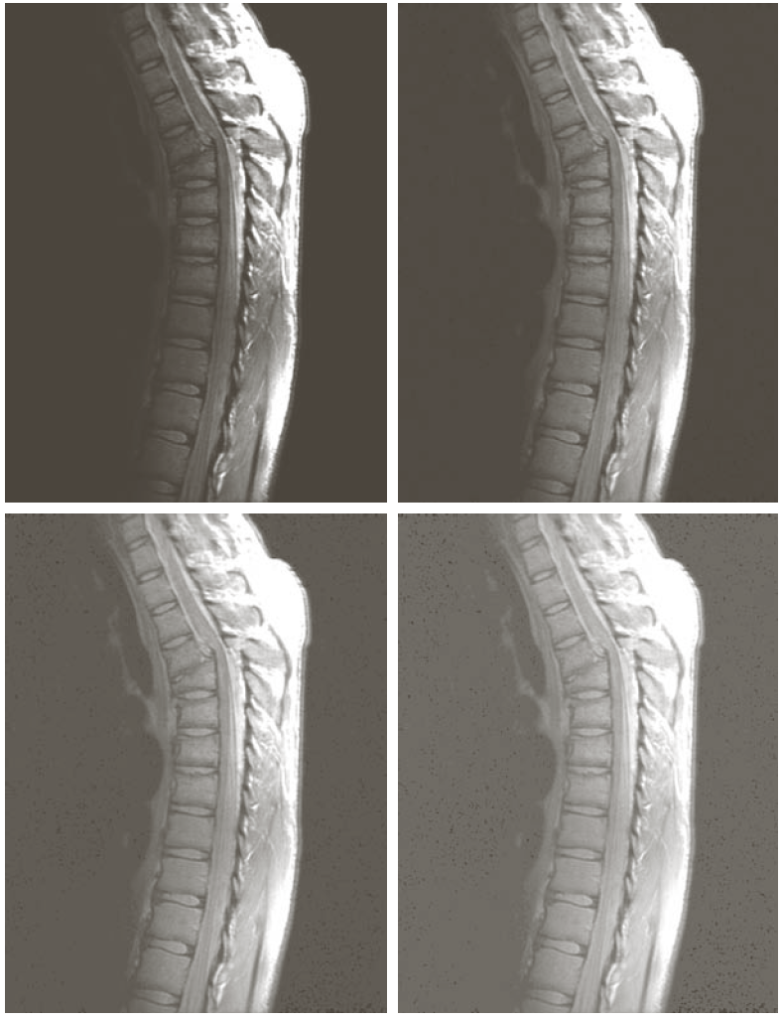
Gamma correction; Dark to light
Images: Gonzalez & Woods, 3rd edition
Original image
0.6
0.4
0.3

Slide 17
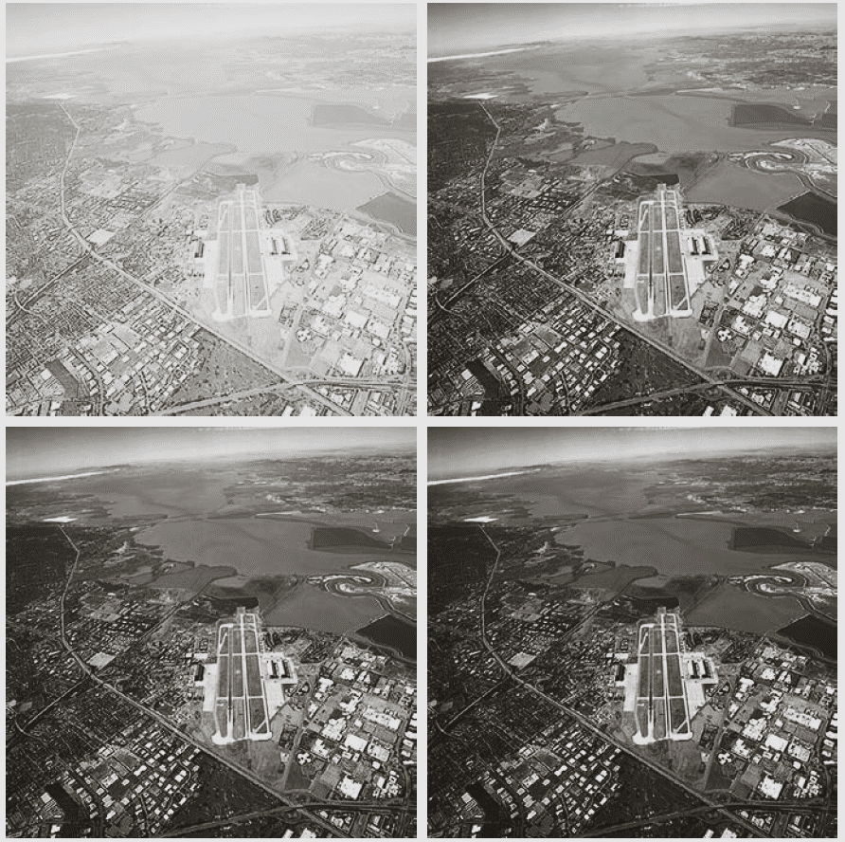
Gamma correction: light to dark
Images: Gonzalez & Woods, 3rd edition
3.0
4.0
5.0

Slide 18
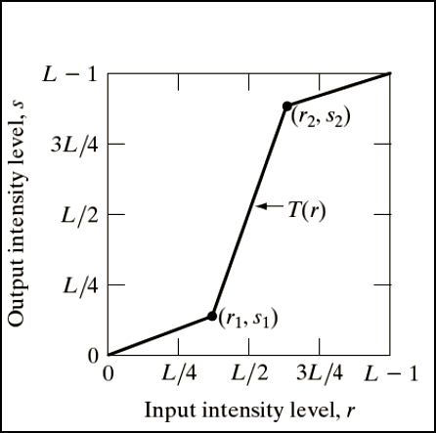
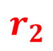
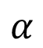

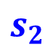
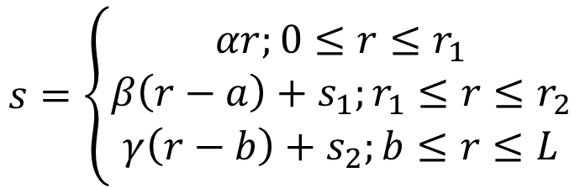
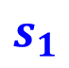
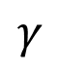
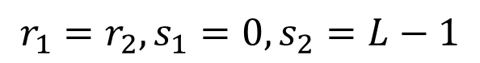
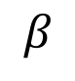
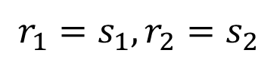
Contrast stretching
Images: Gonzalez & Woods, 3rd edition
$$s=\left\{\begin{aligned}αr;0≤r≤r_{1} \\ β\left(r−a\right)+s_{1};r_{1}≤r≤r_{2} \\ γ\left(r−b\right)+s_{2};b≤r≤L\end{aligned}\right.$$
$$s_{2}$$
Spans the full range of intensity level
$$s_{1}$$
$$r_{1}=s_{1},r_{2}=s_{2}$$
Linear
$$r_{1}=r_{2},s_{1}=0, s_{2}=L−1$$
$$α$$
$$β$$
$$γ$$
Thresholding
$$r_{1}$$
$$r_{2}$$

Slide 19
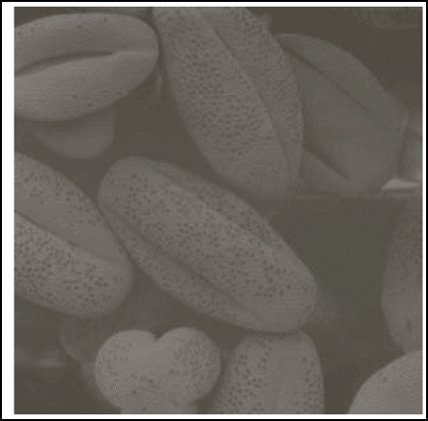
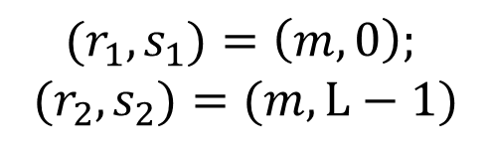
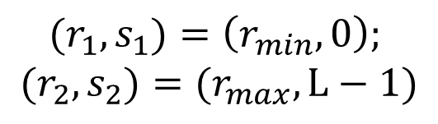
Contrast stretching
Images: Gonzalez & Woods, 3rd edition
Input image
Contrast stretched image
Thresholded image
$${(r}_{1},s_{1})=\left(r_{min},0\right);$$
$${(r}_{2},s_{2})=(r_{max},L−1)$$
$${(r}_{1},s_{1})=\left(m,0\right);$$
$${(r}_{2},s_{2})=(m,L−1)$$

Slide 20
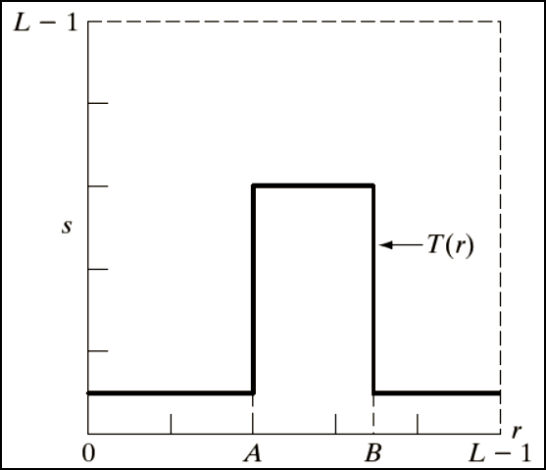
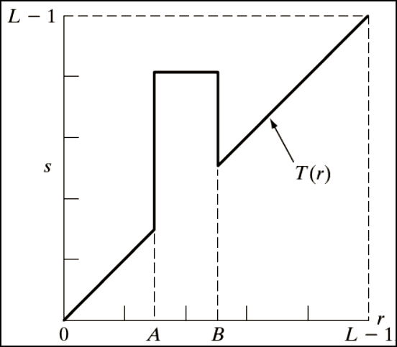
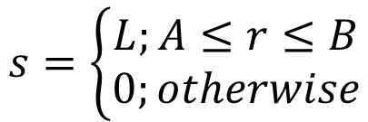
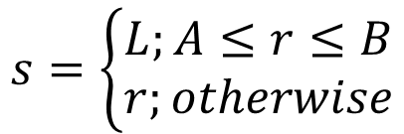
Gray-level slicing
Highlight a specific range of gray values
Without background
With background
$$s=\left\{\begin{aligned}L;A≤r≤B \\ 0;otherwise\end{aligned}\right.$$
$$s=\left\{\begin{aligned}L;A≤r≤B \\ r;otherwise\end{aligned}\right.$$

Slide 21
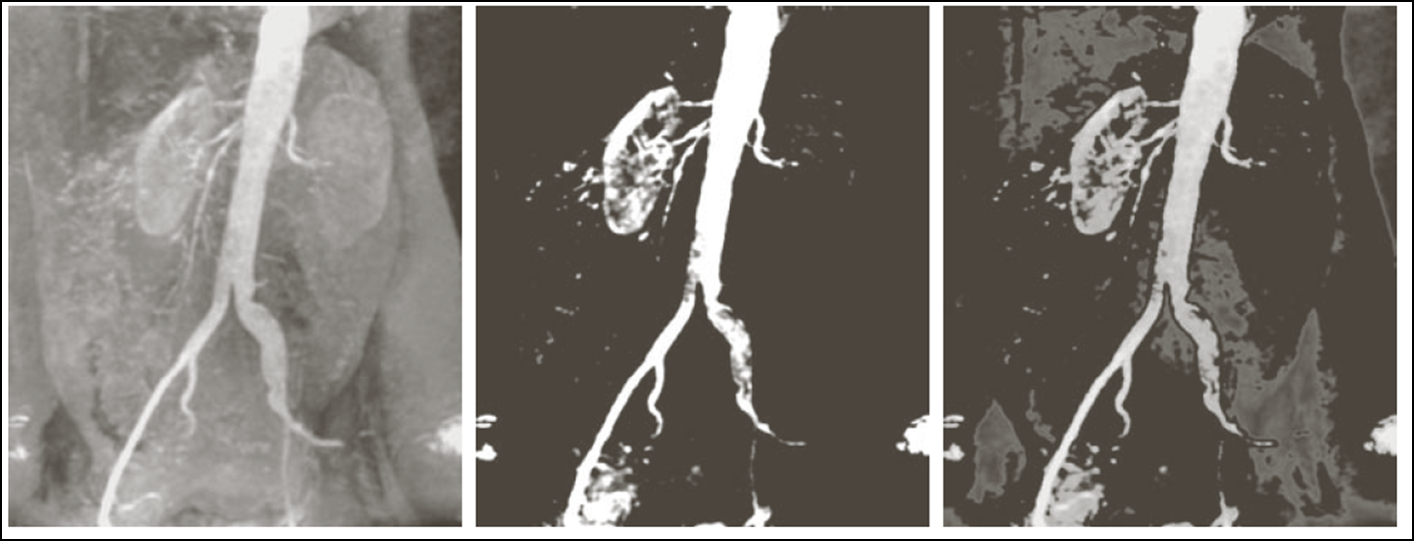
Example
Input image
Without background
With background

Slide 22
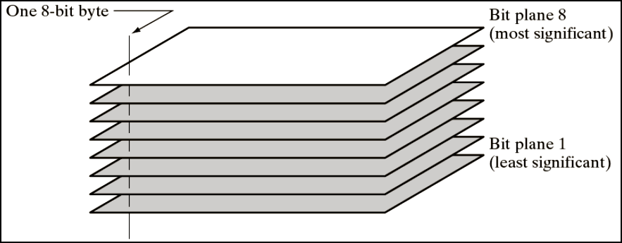
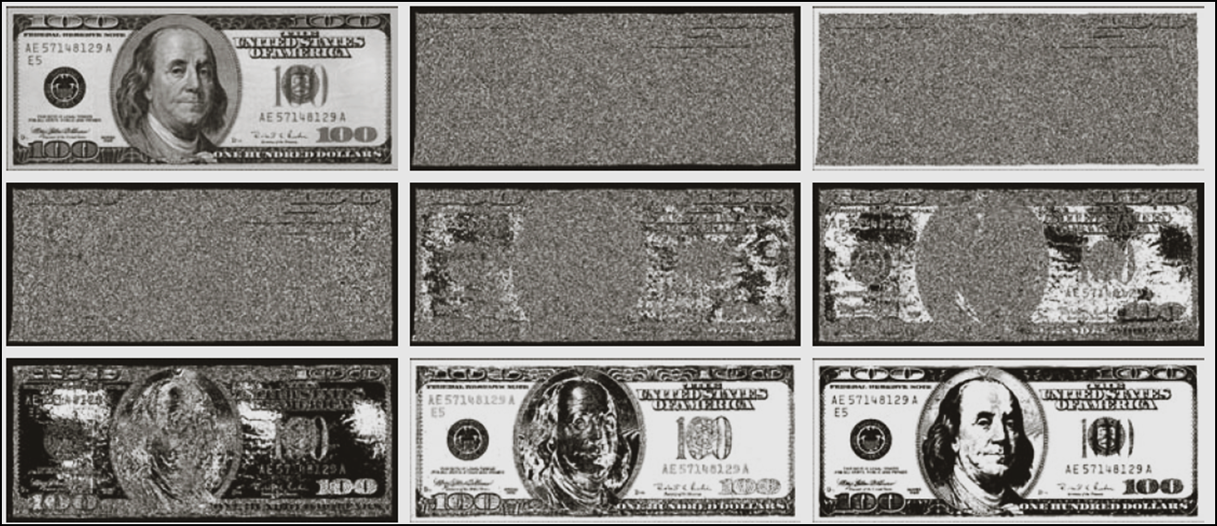
Bit plane slicing
Bit plane representation of 8 bit images
1
2
3
4
5
6
7
8

Slide 23
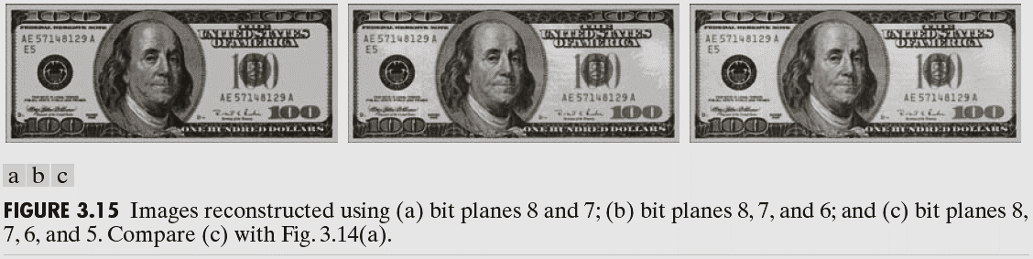
Reconstruction of images
8+7
8+7+6+5
8+7+6

Slide 24
Thank you
Next lecture: Histogram Processing

